Slide 1
Unit 4: Object-Oriented Modeling Using UML
Notation

Slide 2
Unit 4: Object-Oriented Modeling Using UML Notation
Use Case Modeling
Sequence & Communication Diagrams
Reuse and Variability
Actors, Components, and Generalization

Slide 3
4.1 Elaborating Use Cases and Use Case Diagram
What Are Use Cases?
Definition
  A use case describes how actors interact with a system to achieve a business goal.
Purpose
  Capture functional requirements
  Describe system behavior from the user perspective
  Establish common understanding between business & development teams
Key Elements
  Actor
  Use case name
  Pre-conditions & Post-conditions
  Main & alternative flows

Slide 4
How to Elaborate a Use Case
  Identify primary actor and goal
  Describe main success scenario
  List extensions / alternate flows
  Add business rules and constraints
  Specify triggers, preconditions, and postconditions
Outcome
  Well-structured, complete, and testable requirement specification

Slide 5
Use Case Diagram Overview
Purpose
  Visualize actors and their interactions with the system
  Provide a high-level overview of system functionality
Major Components
  Actors
  Use cases
  Associations
  Include/Extend relationships
  System boundary

Slide 6
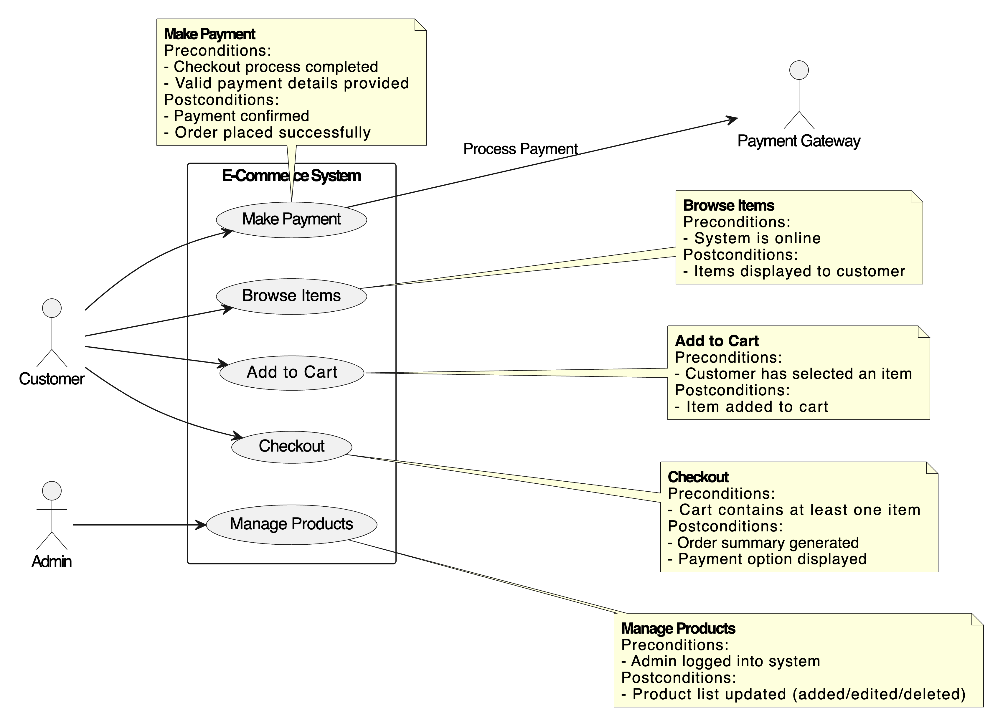
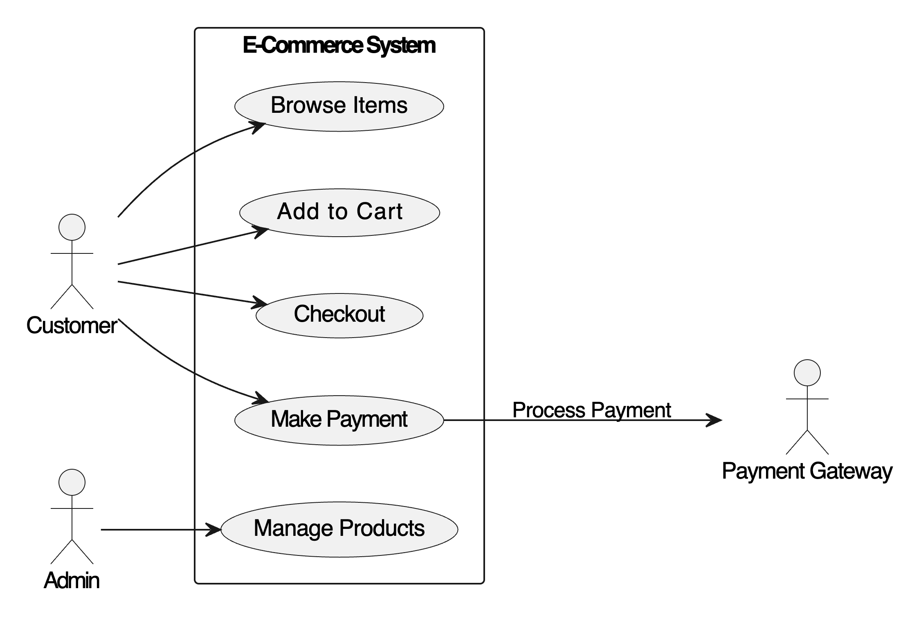
Example Use Case Diagram
Actors: Customer, Payment Gateway, Admin
Use Cases: Browse Items, Add to Cart, Checkout, Make Payment, Manage Products

Slide 7
4.1.1 Use Cases for Reuse
Use Cases for Reuse Concept
Why Reuse Use Cases?
  Reduces duplication
  Improves maintainability
  Ensures consistent behavior across modules
Reuse Mechanisms
  <<include>> for mandatory behavior
  <<extend>> for optional behavior
  Generalized use cases

Slide 8
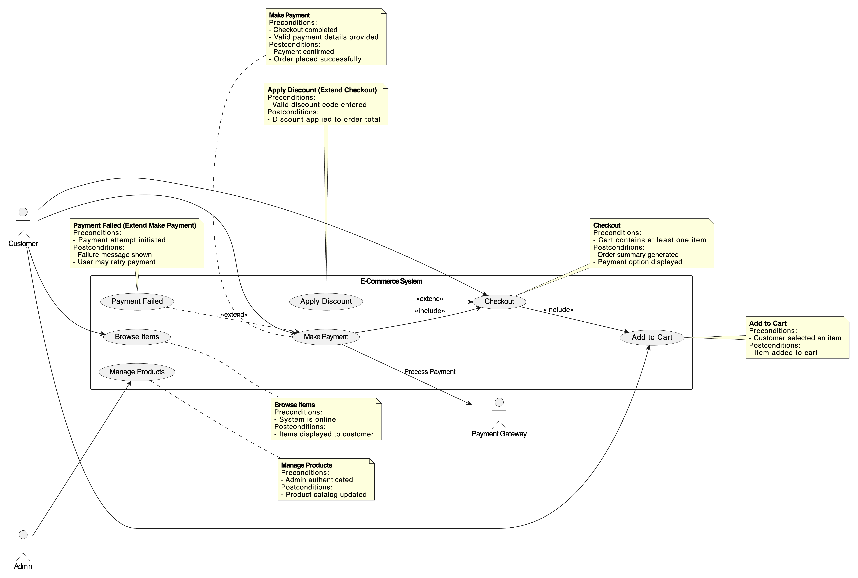
Assumptions for Include/Extend
Checkout includes Add to Cart (cart review always part of checkout).
Make Payment includes Checkout (payment always follows checkout).
Payment Failed extends Make Payment.
Apply Discount extends Checkout (optional behavior).

Slide 9
Relationship
<<include>> Relationship
Represents common functionality used by multiple use cases
Example
  “Login” included by:
    Place Order
    View Profile
    Manage Products
<<extend>> Relationship
Represents optional or conditional functionality
Example
  “Apply Discount Coupon” extends “Checkout”
  Executed only if the system detects a valid coupon

Slide 10
Rules and line style
«include» Relationship
Meaning
  One use case always calls another use case.
  The included use case is mandatory.
  It represents common, reusable behavior.
Example
  Checkout includes Calculate Total Price
  (because every checkout MUST calculate the total)
Line Style
  ✔️ Dashed line
  ✔️ Arrow pointing to the included use case
«extend» Relationship
Meaning
  Optional or conditional behavior.
  The extending use case occurs only under certain conditions.
Base use case remains complete without the extension.
Example
  Place Order extends Apply Discount
  (only if a discount coupon is applied)
Line Style
  ✔️ Dashed line
  ✔️ Arrow points from extension → base use case

Slide 11
4.1.2 Use Cases and Components
Why Link Use Cases to Components?
  Ensures system architecture supports functional requirements
  Maps user interactions to backend modules
Component Mapping
  Use case elements → service components
  Actor actions → APIs or controllers
  Business rules → domain logic components

Slide 12
Benefits of Mapping Use Cases to Components
What Is “Mapping Use Cases to Components”?
  Mapping use cases to components is the process of connecting what the system must do (use cases) to how the system is organized internally (components).
👉 Use Case = User goal or system behavior from the user’s perspective
  Example: “Checkout Order,” “Make Payment,” “Search Books.”
👉 Component = Modular building block of the system
  Example: “Payment Service,” “Order Manager,” “Inventory Component.”
Mapping them means:
You take each use case and identify which components must work together to fulfill it.
📌 It answers the key question:
“Which part of the system is responsible for implementing this use case?”

Slide 13
Mapping Use Cases to Components
Why Do We Do This?
  To ensure the system architecture supports all required functionalities
  To assign responsibilities to correct components
  To help developers understand which component implements which feature
  To simplify maintenance, traceability, and testing
How To Map Use Cases to Components (Step-by-Step)
Step 1: Identify Use Cases Start with the use case diagram or list. Example Use Cases: Browse Items Add to Cart Checkout Make Payment | Step 2: Identify System Components Break the system into modules/components. Example Components: Product Catalog Component Cart Component Order Management Component Payment Gateway Component User Management Component | Step 3: Determine Which Component Handles Each Use Case For each use case, ask: 👉 Which component contains the logic to do this? 👉 Which component provides data for this operation? 👉 Which components must collaborate?

Slide 14
Step 4: Create a Mapping Table or Diagram
A simple table, matrix, or UML component diagram shows the mapping.
Example: Mapping Matrix
Use Case → / Component ↓ | Catalog | Cart | Order | Payment
Browse Items | ✔️
Add to Cart |  | ✔️
Checkout |  | ✔️ | ✔️
Make Payment |  |  | ✔️ | ✔️
Benefits of Mapping Use Cases to Components
Understanding how use cases relate to system components
Strengthening architecture design through clear traceability
Supporting both analysis and implementation phases

Slide 15
4.1.3 Separation of Variant Behavior
Variant Behavior in Use Cases
What Is Variant Behavior?
Behavior that changes based on conditions, user types, environment, etc.
Examples
  Payment flow differs for Credit Card vs Wallet
  Admin features differ from User features

Slide 16
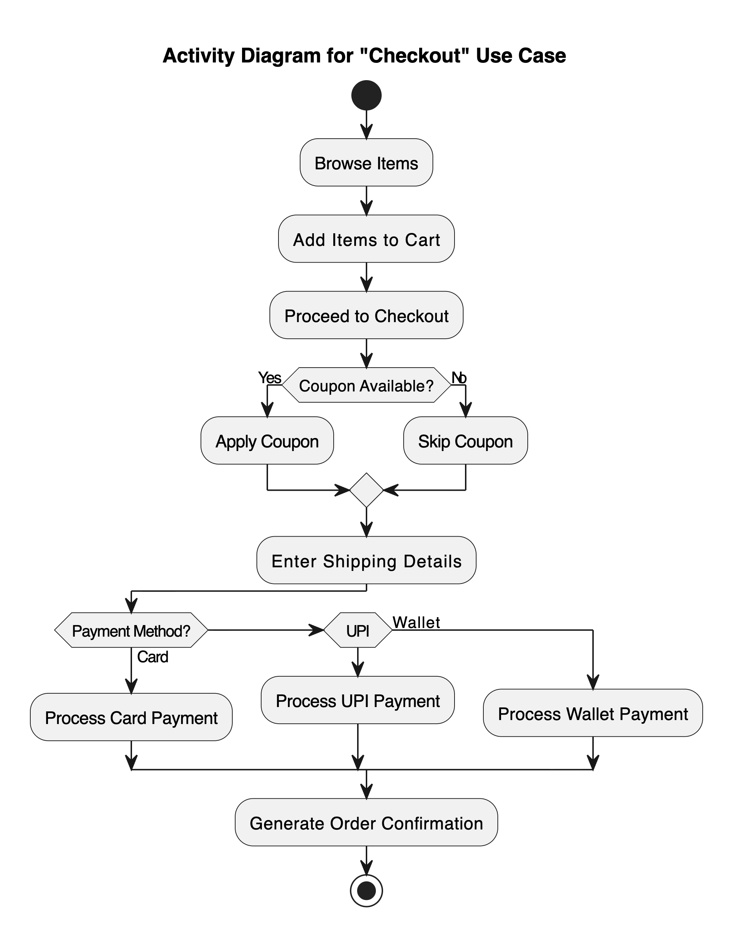
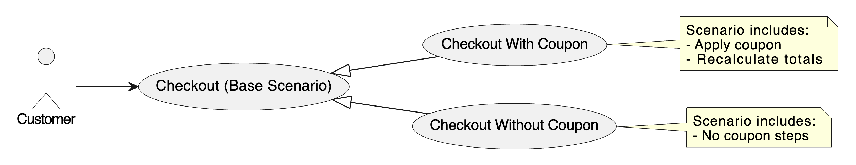
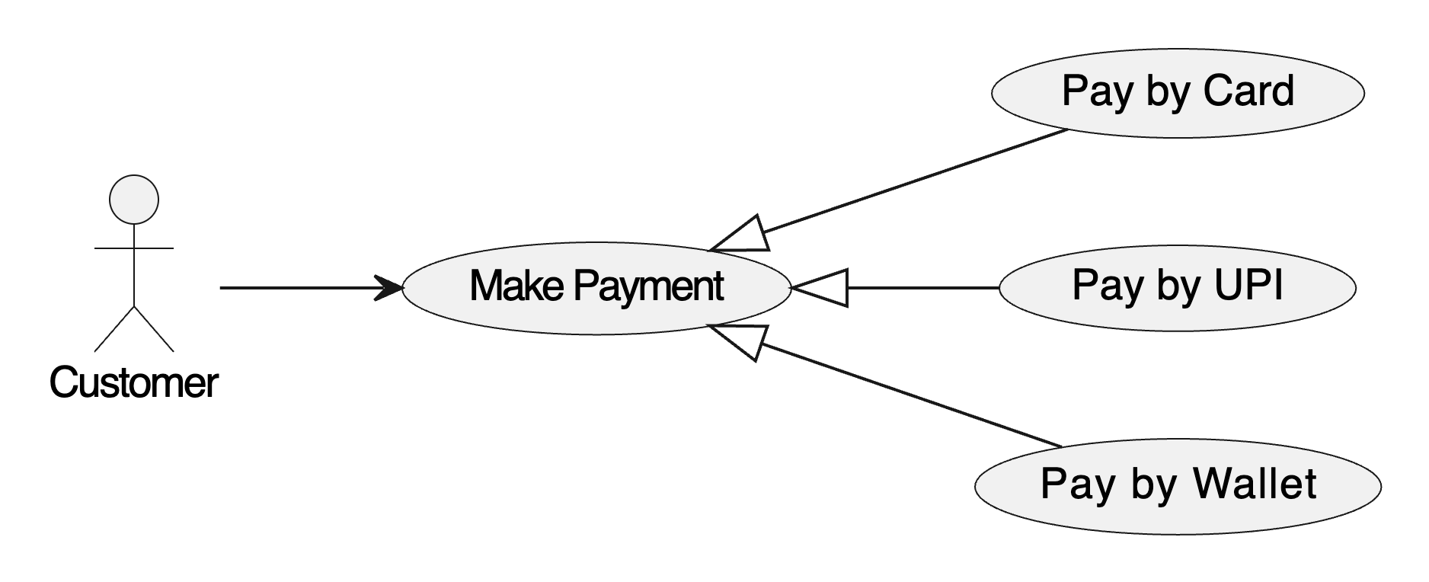
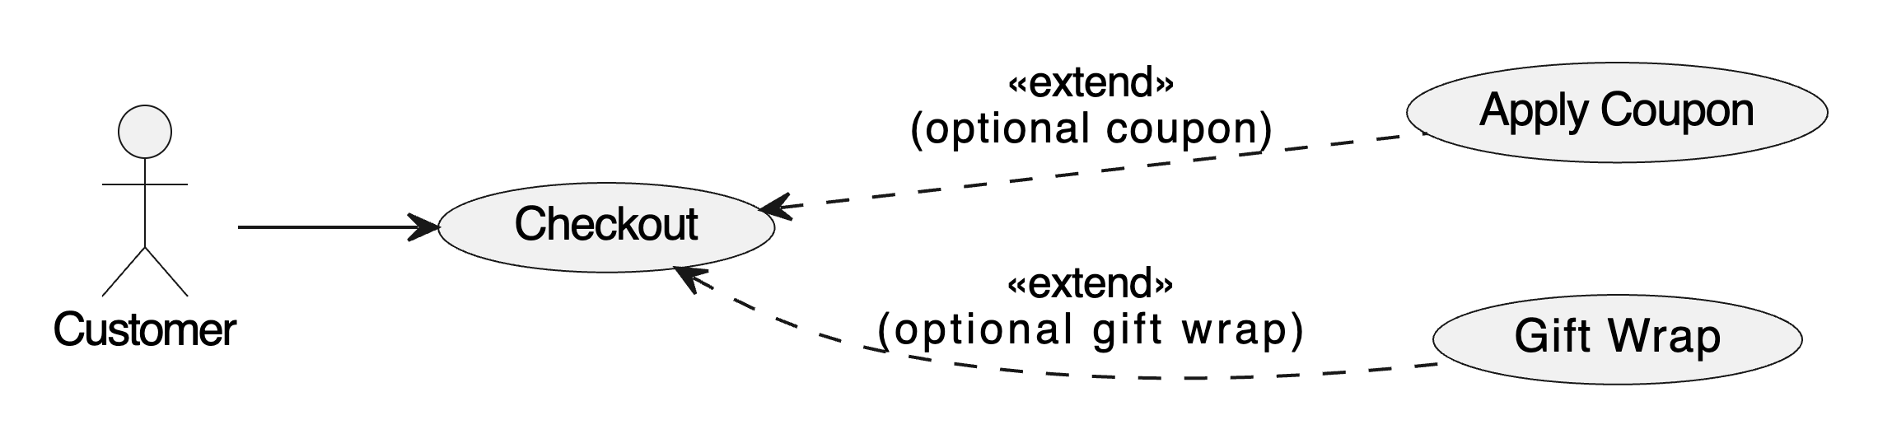
How to Model Variant Behavior
Scenario based variant
Techniques
  <<extend>> for optional/conditional behavior
  Generalization of use cases
  Using activity/decision nodes
  Creating scenario-based variants
Outcome
Flexible, scalable requirements modeling
Generalization of use cases
Optional or conditional

Slide 17
4.1.4 Generalization
Definition
  A relationship where a child use case inherits behavior from a parent use case.
What is Use Case Generalization?
Use Case Generalization is a UML mechanism where:
  A parent (base) use case defines common behavior.
  Child (specialized) use cases inherit that behavior and add their own unique steps.
It models alternative ways of achieving a similar goal.
➜ Think of it as:
  “Different versions of the same use case.”

Slide 18
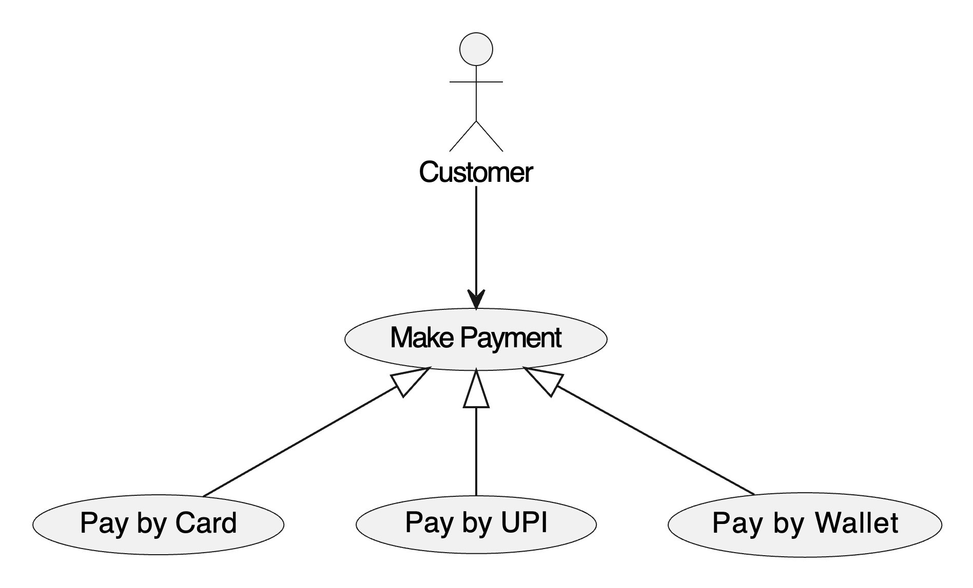
When to Use Generalization?
When to Use
  When multiple use cases share a common base flow
  When specializations are required
Use generalization when:
🔸 Different use cases achieve the same goal in different ways
Example:
Pay by Card
Pay by UPI
Pay by Wallet
All are variations of Make Payment.
🔸 Variants have different flows, rules, or constraints
Example:
Login via Password
Login via OTP
Login via Social Media
🔸 Variant behavior could be independent use cases
Not optional (like extend), but alternative ways of accomplishing a task.

Slide 19
Concept | Meaning | When to Use | Symbol
include | Reusable mandatory sub-flow | Same steps needed in multiple use cases | dashed arrow with «include»
extend | Optional / conditional flow | Additional behavior only sometimes | dashed arrow with «extend»
generalization | Alternative ways of same parent behavior | Variants with unique flows | solid line with closed arrow

Slide 20
Real-World Examples of Use Case Generalization
🔹 Order Delivery
Deliver Order (parent)
  Home Delivery
  Pickup Point Delivery
  Drone Delivery
Authentication
Authenticate User (parent)
  Login with Password
  Login with OTP
  Login with Biometrics
Search
Search Items (parent)
  Search By Name
  Search By Category
  Search By Filters
Booking
Book Ticket (parent)
  Book Flight
  Book Bus
  Book Train

Slide 21
4.1.5 Actor as Classes
Actors as Classes Concept
Why Treat Actors as Classes?
  Actors have attributes (ID, role, permissions)
  Actors exhibit behaviors (log in, request services)
Benefits
  Helps build domain models
  Clarifies responsibilities
  Ensures consistent system interaction
Example
Actor: Customer
  Attributes: CustomerID, Name, Email
  Methods: Login(), ViewItems(), PlaceOrder()

